Slide 1
Classical Mechanics (MP-301)

Slide 2
Physics: The most basic of all sciences!
Physics: The “king” of all sciences!
Physics = The study of structure of matter and energy and their interactions.
Its Applications

Slide 3
Physics: General Discussion
The Goal of Physics (& all of science): To quantitatively and qualitatively describe the “world around us”.
Physics IS NOT merely a collection of facts & formulas!
Physics IS a creative activity!
Physics Observation Explanation.
Requires IMAGINATION!!

Slide 4
Physics & Its Relation to Other Fields
The “Parent” of all Sciences!
The foundation for and is connected to ALL branches of science and engineering.
Also useful in everyday life and in MANY professions
Chemistry
Life Sciences (Medicine also!!)
Architecture
Engineering
Various technological fields

Slide 5
The Nature of Science
Physics is an EXPERIMENTAL science!
Experiments & Observations:
Important first steps toward scientific theory.
It requires imagination to tell what is important
Theories:
Created to explain experiments & observations. Will also make predictions
Experiments & Observations:
Will tell if predictions are accurate.
No theory can be absolutely verified
But a theory CAN be proven false!!!

Slide 6
Theory
Quantitative (mathematical) description of experimental observations.
Not just WHAT is observed but WHY it is observed as it is and HOW it works the way it does.
Tests of theories:
Experimental observations:
More experiments, more observation.
Predictions:
Made before observations & experiments.

Slide 7
Model, Theory, Law
Model: An analogy of a physical phenomenon to something we are familiar with.
Theory: More detailed than a model. Puts the model into mathematical language.
Law: Concise & general statement about how nature behaves. Must be verified by many, many experiments! Only a few laws.
Not comparable to laws of government!

Slide 8
How does a new theory get accepted?
Predictions agree better with data than old theory
Explains a greater range of phenomena than old theory
Example:
Aristotle believed that objects would return to a state of rest once put in motion.
Galileo realized that an object put in motion would stay in motion until some force stopped it.

Slide 9
The Structure of Physics

Slide 10
Mechanics
The science of HOW objects move (behave) under given forces.
(Usually) Does not deal with the sources of forces. Answers the question: “Given the forces, how do objects move”?

Slide 11
Mechanics: “Classical” Mechanics
“Classical” Physics:
“Classical” ≡ ≈ Before the 20th Century
The foundation of pure & applied macroscopic physics & engineering!
Newton’s Laws + Boltzmann’s Statistical Mechanics (& Thermodynamics): ≈ Describe most of macroscopic world!
However, at high speeds (v ~ c) we need
Special Relativity: (Early 20th Century: 1905)
Also, for small sizes (atomic & smaller) we need
Quantum Mechanics: (1900 through ~ 1930)
“Classical” Mechanics: (17th & 18th Centuries) Still useful today!

Slide 12
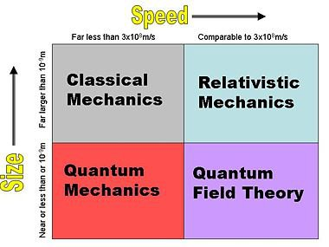
“Classical” Mechanics
The mechanics in this course is limited to macroscopic objects
moving at speeds v much, much smaller than the speed of light
c = 3 × 10⁸ m/s. As long as v << c, our discussion will be valid.
So, we will work
exclusively in the
gray region in the
figure.

Slide 13

Classical Mechanics
Kinematics – how objects move
Translational motion
Rotational motion
Vibrational motion
Dynamics – Forces and why objects move as they do
Statics – special case - forces cause no motion

Slide 14
Classical Mechanics
First began with Galileo (1584-1642), whose experiments with falling bodies (and bodies rolling on an incline) led to Newton’s 1st Law.
Newton (1642-1727) then developed his 3 laws of motion, together with his universal law of gravitation.
Two additional, highly mathematical frameworks were developed by the French mathematician Lagrange (1736-1813) and the Irish mathematician Hamilton (1805-1865).
Together, these three alternative frameworks by Newton, Lagrange, and Hamilton make up what is generally called Classical Mechanics.
They are distinct from the other great forms of non-classical mechanics, Relativistic Mechanics and Quantum Mechanics, but both of these borrow heavily from Classical Mechanics.

Slide 15
This Course
The first part of this course will be a review in terms of the basic ideas of mechanics, which you should have already thoroughly learned in your introductory physics courses.
PRINCIPLE OF VIRTUAL WORK, Constraints, Generalised Coordinates, Velocities And Momenta, D’ Alembert’s Principle
LAGRANGE’S FORMULATION, Variational technique for many independent, variables, Euler Lgrangian differential equation, Application of Lagrange’s equation of motion.
HAMILTON’S EQUATIONS; Hamilton’s canonical equation of, motion, Physical significance of H, Advantage of Hamilton approach,
POISSON BRACKETS, Invariance of Poisson bracket with respect to canonical transformation, Equation of motion in Poisson bracket form.
TWO-BODY CENTRAL FORCE PROBLEM, Reduced mass, Planet orbits, Kepler Laws, Virial theorem.
COLLISIONS AND SCATTERING, Centre of mass and lab frames, Scattering cross section
RIGID BODY DYNAMICS, Euler equations, Euler angles, The inertia tenser, Motion of the symmetric top.
MOTION IN NON-INERTIAL FRAMES, Coriolis Force
HARMONIC OSCILLATOR; NONLINEAR OSCILLATOR; INTRODUCTION TO CHAOS

Slide 16
Space and Time
We live in a three-dimensional world, and for the purpose of this course we can consider space and time to be a fixed framework against which we can make measurements of moving bodies.
Each point P in space can be labeled with a distance and direction from some arbitrarily chosen origin O. Expressed in terms of unit vectors
It is equivalent to write the vector as an ordered triplet of values
We can also write components of vectors using subscripts
Ways of writing vector notation
z axis
z
y axis
x
y
x axis

Slide 17
Other Vector Notations
You will be used to unit vector notation i, j, k, but we will follow the text and use the notation.
At times, it is more convenient to use notation that makes it easier to use summation notation, so we introduce the equivalents:
which allows us to write
In the above example, this form has no real advantage, but in other cases we will meet, this form is much simpler to use. The point is that we may choose any convenient notation, and you should become tolerant of different, but consistent forms of notation.

Slide 18
Vector Operations
Sum of vectors
Vector times scalar
Scalar product, or dot product
Vector product, or cross product
θ

Slide 19
Differentiation of Vectors
This course makes heavy use of Calculus (and differential equations, and other forms of advanced mathematics). In general, we will refresh your memory about the techniques you will need as they come up, but we will do so from a Physics perspective—only paying lip-service to the underlying mathematical proofs.
What we need now is a simple form of something called Vector Calculus. As long as you remember that vectors are just triplets of numbers, and vector equations can be thought of as three separate equations, you will be fine.
For now, consider only the derivative of the position vector r(t), which you should know gives the velocity v(t) = dr(t)/dt. Likewise, the derivative of the velocity (the second derivative of the position) gives the acceleration: a(t) = dv(t)/dt = d²r(t)/dt². Formally:
for scalars:
for vectors:

Slide 20
Differentiation of Vectors
By the usual rules of differentiation, the derivative of a sum of vectors is
derivative of a scalar times a vector follows the usual product rule
Also note: so
implies that the unit vectors are constant (i.e. ).

Slide 21
Mass and Force
What is the difference between mass and weight?
Mass has to do with inertial force (ma).
Weight has to do with gravitational force (mg).
In the first case, the mass is “resistance to changes in motion” while in the second case it is a rather mysterious “attractive property” of matter
Inertial balance:
m₁
Allows measurement of inertial mass
without mixing in gravitational force.
m₂

Slide 22
Point Mass (Particle)
For now, we want to focus on the concept of a point mass, or particle. This is an approximation, which is worthwhile to look at carefully. It basically refers to a body that can move through space but has NO internal degrees of freedom (rotation, flexure, vibrations).
Later we will talk about bodies as collections of particles, or a continuous distribution of mass, and in considering such bodies the laws of motion are considerably more complicated.
Despite this being an approximation, the approximation is still useful in many cases, such as for elementary particles (protons, neutrons, electrons), or even planets and stars (sometimes).

Slide 23
Newton’s Three Laws
Law of Inertia
In the absence of forces, a particle moves with constant velocity v.
(An object in motion tends to remain in motion, an object at rest tends to remain at rest.)
Force Law
For any particle of mass m, the net force F on the particle is always equal to the mass m times the particle’s acceleration: F = ma.
Conservation of Momentum Law
If particle 1 exerts a force F₂₁ on particle 2, then particle 2 always exerts a reaction force F₁₂ on particle 1 given by F₁₂ = − F₂₁.
(For every action there is an equal and opposite reaction.)

Slide 24
Aside: Dot Notation
Dot Notation:
We will be using this dot notation extensively. It means differentiation with respect to time, t (only!).
You may have seen “prime” notation, but if the differentiation is not with respect to time, it is NOT equivalent to y-dot.
y-dot means dy/dt only.

Slide 25
Equivalence of First Two Laws
The Law of Inertia and the Force Law can be stated in equivalent ways.
Obviously, if , then in the absence of forces
Thus, the velocity is constant (objects in motion tend to remain in motion) and could be zero (objects at rest tend to remain at rest).
The second law can be rewritten in terms of momentum:
In Classical Mechanics, the mass of a particle is constant, hence
So we can write .
In words, forces cause a change in momentum, and conversely any change in momentum implies that a force is acting on the particle.

Slide 26
The Equation of Motion
Newton’s Second Law is the basis for much of Classical Mechanics, and the equation has another name—the equation of motion.
The typical use of the equation of motion is to write
where the right hand side lists all of the forces acting on the particle.
In this text, an even more usual way to write it is:
which is perhaps an easier way to understand why it is called the equation of motion. This relates the position of the particle vs. time to the forces acting on it, and obviously if we know the position at all times we have an equation of motion for the particle.

Slide 27
Differential Equations
Most of you should have had a course in differential equations by now, or should be taking the course concurrently.
A differential equation is an equation involving derivatives, in this case derivatives of the particle position r(t).
Consider the one-dimensional equation for the position x(t) of a particle under a constant force:
This equation involves the second derivative (with respect to time) of the position, so to get the position we simply integrate twice:
This was so easy we did not actually need to know the theory of differential equations, but we will meet with lots of more complicated equations where the DiffEQ theory is needed, and will be introduced as needed.

Slide 28
Third Law and Conservation of Momentum
Newton’s first two laws refer to forces acting on a single particle. The Third Law, by contrast, explicitly refers to two particles interacting—the particle being accelerated, and the particle doing the forcing.
Introduce notation F₂₁ (F-on-by) to represent the force on particle 2 by particle 1. Then
Newton’s Third Law
If particle 1 exerts a force F₂₁ on particle 2, then particle 2 always exerts a reaction force F₁₂ on particle 1 given by F₁₂ = − F₂₁.
F₁₂
1
F₁^{ext}
F₂₁
F^{ext}₁
2
F₂^{ext}
F^{ext}₂

Slide 29
Multi-Particle Systems
It should be fairly obvious how to extend this to systems of N particles, where N can be any number, including truly huge numbers like 10²³.
Let α or β designate one of the particles. Both α and β can take any value 1, 2, …, N. The net force on particle α is then
where the sum runs over all particles except α itself (a particle does not exert a force on itself).
The total force on the system of particles is just the sum of all of the
Each term F_{αβ} can be paired with F_{βα}:

Slide 30
Law of Conservation of Linear Momentum
When the total external force on a system is zero, the total momentum of the system remains constant

Slide 31
Law of Conservation of Momentum (collisions):
The total (vector) momentum before a collision =
the total (vector) momentum after a collision.
⇒ p_{total} = p_{A} + p_{B} = (p_{A})′+ (p_{B})′ = constant
Or: Δp_{total} = Δp_{A} + Δp_{B} = 0
p_{A} = m_{A}v_{A}, p_{B} = m_{B}v_{B}, Initial momenta
(p_{A})′ = m_{A}(v_{A})′, (p_{B})′ = m_{B}(v_{B})′, Final momenta
⇒ m_{A}v_{A} + m_{B}v_{B} = m_{A}(v_{A})′ + m_{B} (v_{B})′

Slide 32
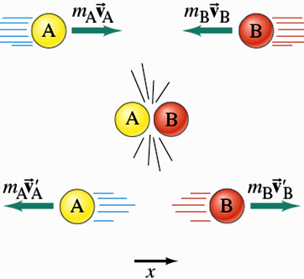
Example: 2 billiard balls collide (zero external force)
The vector sum of the momenta is a constant!
Vector sum of momenta
before = Vector sum of
momenta after!
Vector sum of momenta = constant!

Slide 33
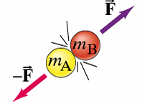
Another brief Proof, using Newton’s 2nd & 3rd Laws
Two masses, m_{A} & m_{B} in collision:
Internal forces: F_{AB} = - F_{BA} by
Newton’s 3rd Law
Newton’s 2nd Law:
The force on A, due to B, for a small time Δt:
F_{AB} = Δp_{A}/Δt = m_{A}[(v_{A})′ - v_{A}]/Δt
The force on B, due to A, for the same small Δt:
F_{BA} = Δp_{B}/Δt = m_{B}[(v_{B})′ - v_{B}]/ Δt
Newton’s 3rd Law: F_{AB} = - F_{BA} = F
⇒ m_{A}[(v_{A})′ - v_{A}]/Δt = - m_{B}[(v_{B})′ - v_{B}]/Δt
or: m_{A}v_{A} + m_{B}v_{B} = m_{A}(v_{A})′ + m_{B} (v_{B})′ ⇒ Proven!
So, for Collisions: m_{A}v_{A} + m_{B}v_{B} = m_{A}(v_{A})′ + m_{B} (v_{B})′

Slide 34
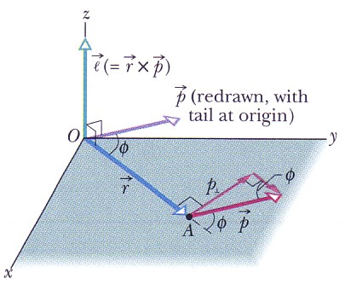
Torque and angular momentum
Here, p is the linear momentum mv of the object.

Slide 35
Newton's second law in angular form
Linear form
No surprise:
angular form
The vector sum of all the torques acting on a particle is equal to the time rate of change of the angular momentum.
For a system of many particles, the total angular momentum is:
The net external torque acting on a system of particles is equal to the time rate of change of the system's total angular momentum.

Slide 36
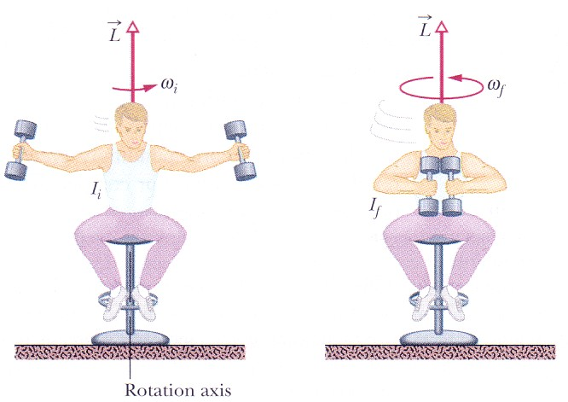
Conservation of angular momentum
It follows from Newton's second law that:
If the net external torque acting on a system is zero, the angular momentum of the system remains constant, no matter what changes take place within the system.

Slide 37
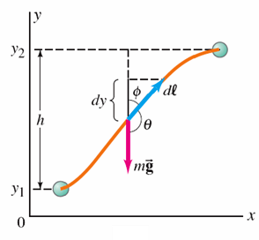
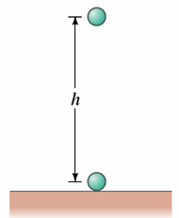
Conservative & Non-conservative Forces
Definition: A force is conservative if & only if
the work done by that force on an object moving from one point to another depends ONLY on the initial & final positions of the object, & is independent of the particular path taken. Example: gravity.
Notes:
Figure 8-1. Caption: Object of mass m: (a) falls a height h vertically; (b) is raised along an arbitrary two-dimensional path.

Slide 38
Conservative Force: Another definition:
A force is conservative if the net work done by the force on an object moving around any closed path is zero.
Notes:
Figure 8-2. Caption: (a) A tiny object moves between points 1 and 2 via two different paths, A and B. (b) The object makes a round trip, via path A from point 1 to point 2 and via path B back to point 1.

Slide 39
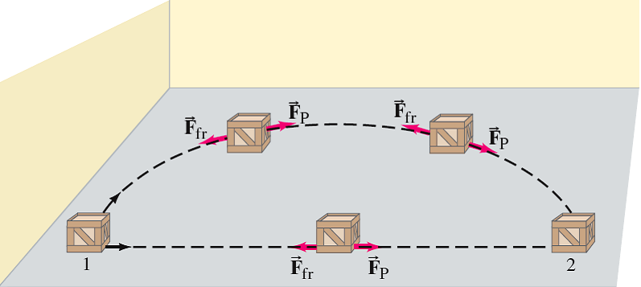
If friction is present, the work done depends not only on the starting & ending points, but also on the path taken. Friction is a Nonconservative Force!
Friction is a Nonconservative Force.
The work done by friction depends on the path!
Notes:
Figure 8-3. Caption: A crate is pushed at constant speed across a rough floor from position 1 to position 2 via two paths, one straight and one curved. The pushing force F_{P} is always in the direction of motion. (The friction force opposes the motion.) Hence for a constant magnitude pushing force, the work it does is W = F_{P}d, so if d is greater (as for the curved path), then W is greater. The work done does not depend only on points 1 and 2; it also depends on the path taken.

Slide 40
Potential Energy
A mass can have a Potential Energy due to its environment
Potential Energy (U) ≡
The energy associated with the position or configuration of a mass.
Examples of potential energy:
A wound-up spring
A stretched elastic band
An object at some height above the ground

Slide 41
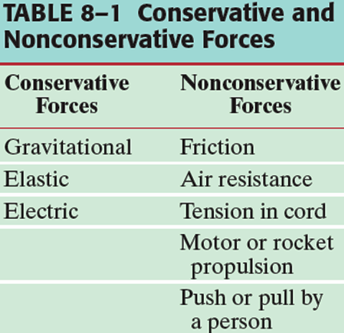
Potential Energy:
Can only be defined for
Conservative Forces!

Slide 42
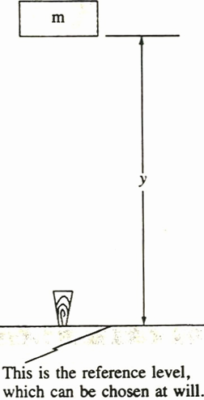
Potential Energy (U) ≡ Energy associated with the position or configuration of a mass.
Potential work done!
Gravitational Potential Energy:
U_{grav} ≡ mgy
y = distance above Earth
m has the potential to do work
mgy when it falls
(W = Fy, F = mg)

Slide 43
Gravitational Potential Energy
In raising a mass m to a height h, the work done by the external force is
So we Define the Gravitational Potential Energy at height y above some reference point as
Notes:
Figure 8-4. Caption: A person exerts an upward force F_{ext} = mg to lift a brick from y₁ to y₂ .

Slide 44
Consider a problem in which the height of a mass above the Earth changes from y₁ to y₂:
The Change in Gravitational Potential Energy is:
ΔU_{grav} = mg(y₂ - y₁)
The work done on the mass by gravity is: W = ΔU_{grav}
y = distance above Earth
Where we choose y = 0 is arbitrary, since we take
the difference in 2 y’s in calculating ΔU_{grav}

Slide 45
Of course, this potential energy will be converted to kinetic energy if the object is dropped.
Potential energy is a property of a system as a whole, not just of the object (because it depends on external forces).
If U_{grav} = mgy, from where do we measure y?
Doesn’t matter, but we need to be consistent about this choice!
This is because only changes in potential energy can be measured.

Slide 46
Work & Energy
Particle is acted on by a total external force F. Work done ON particle in moving it from position 1 to position 2 in space is defined as line integral
(ds = differential path length, assume mass m = constant)
W₁₂ ≡ ∫F•ds (limits: from 1 to 2)
Newton’s 2nd Law (& chain rule of differentiation): F•ds = (dp/dt)•(dr/dt) dt
= m(dv/dt)•v dt = (½)m[d(v•v)/dt] dt
= (½)m(dv²/dt) dt

Slide 47
Work-Energy Principle
⇒ W₁₂ = ∫F•ds = (½)m∫[d(v²)/dt] dt
= (½)m∫d(v²) (limits: from 1 to 2)
Or: W₁₂ = (½)m[(v₂)² - (v₁)²]
Kinetic Energy of Particle: T ≡ (½)mv²
⇒ W₁₂ = T₂ - T₁ = ΔT
Total Work done = Change in kinetic energy
(Work-Energy Principle or Work-Energy Theorem)

Slide 48
Conservative Forces
Special Case: Force F is such that the work W₁₂ does not depend on path between points 1 & 2:
F and the system are then ≡ Conservative.
Alternative definition of conservative: Particle goes from point 1 to point 2 & back to point 1 (different paths, total path is closed). Work done is
W₁₂ + W₂₁ = ∮F•ds = 0
Work done in closed path is zero
Because path independence means W₁₂ = - W₂₁

Slide 49
Conservative Forces ⇒ Potential Energy
Consider W₁₂ = ∫F•ds (limits: from 1 to 2)
Conservative force F ⇒ W₁₂ is path independent.
Clearly, friction & similar forces are not conservative!
For conservative forces, define a Potential Energy function V(r). By definition:
W₁₂ = ∫F•ds = V₁ - V₂ = - ΔV
Depends only on end points 1 & 2
For conservative forces the total work done =
- (the change in potential energy)

Slide 50
Potential Energy Function
For conservative forces:
W₁₂ = ∫F•ds = V₁ - V₂ = - ΔV
Vector calculus theorem. W₁₂ path independent
⇒ F = gradient of some scalar function. That is
this is satisfied if & only if the force has the form:
F = - ∇V(r) (minus sign by convention)
For conservative forces, the force is the negative gradient of the potential energy (or potential).

Slide 51
For conservative forces: F = - ∇V(r).
⇒ Can write: F•ds = - ∇V(r)•ds = -dV
⇒ F = - (∂V/∂s)
Physical (experimental) quantity is F = - ∇V(r)
⇒ The zero of V(r) is arbitrary
(since F is a derivative of V(r)!)

Slide 52
Energy Conservation
For conservative forces only we had:
W₁₂ = ∫F•ds = V₁ - V₂ (independent of path)
In general, we had (Work-Energy Principle):
W₁₂ = T₂ - T₁
Combining ⇒ For conservative forces:
V₁ - V₂ = T₂ - T₁ or ΔT + ΔV = 0
or T₁ + V₁ = T₂ + V₂
or E = T + V = constant
E = T + V ≡ Total Mechanical Energy
(or just Total Energy)

Slide 53
For conservative forces:
ΔT + ΔV = 0
or T₁ + V₁ = T₂ + V₂
or E = T + V = constant (conserved)
Energy Conservation Theorem for a Particle:
If only conservative forces are acting on a particle, then the total mechanical energy of the particle, E = T + V, is conserved.

Slide 54
Consider a special case where F is a function of both position r & time t: F = F(r,t)
Further, suppose we can define a function V(r,t) such that: F = - (∂V/∂s)
⇒ Work done on particle in differential distance ds is still F•ds = - (∂V/∂s)ds
However, in this case, cannot write F•ds = -dV since V is a function of both time & space. May still define a total mechanical energy E = T + V. However, E is no longer conserved! E = E(t)!!
(Conserved ⇒ dE/dt = 0 )

Slide 55
Mechanics of a System of Particles

Slide 56
Mechanics of a System of Particles
Generalization to many (N) particle system:
Distinguish External & Internal Forces.
Newton’s 2nd Law (eqtn. of motion), particle i:
∑_{j}F_{ji} + F_{i}^{(e)} = (dp_{i}/dt) = p_{i}
F_{i}^{(e)} ≡ Total external force on the i^{th} particle.
F_{ji} ≡ Total (internal) force on the i^{th} particle due to the j^{th} particle.
Fjj = 0 of course!!

Slide 57
∑_{j}F_{ji} + F_{i}^{(e)} = (dp_{i}/dt) = p_{i} (1)
Assumption: Internal forces F_{ji} obey Newton’s 3rd Law: F_{ji} = - F_{ij}
≡ The “Weak” Law of Action and Reaction
Original form of the 3rd Law, but is not satisfied by all forces!
Sum (1) over all particles in the system:
∑_{i,j(≠i)}F_{ji} + ∑_{i}F_{i}^{(e)} = ∑_{i} (dp_{i}/dt)
= d(∑_{i}m_{i}v_{i})/dt = d²(∑_{i}m_{i}r_{i})/dt²

Slide 58
Newton’s 2nd Law for Many Particle Systems
Rewrite as:
d²(∑_{i}m_{i}r_{i})/dt² = ∑_{i} F_{i}^{(e)} + ∑_{i,j(≠i)}F_{ji} (2)
∑_{i} F_{i}^{(e)} ≡ total external force on system ≡ F^{(e)}
∑_{i,j(≠i)}F_{ji} ≡ 0. By Newton’s 3rd Law:
F_{ji} = - F_{ij} ⇒ F_{ji} + F_{ij} = 0 (cancel pairwise !)
So, (2) becomes (r_{i} ≡ position vector of m_{i}):
d²(∑_{i}m_{i}r_{i})/dt² = F^{(e)} (3)
⇒ Only external forces enter Newton’s 2nd Law to get the equation of motion of a many particle system!!

Slide 59
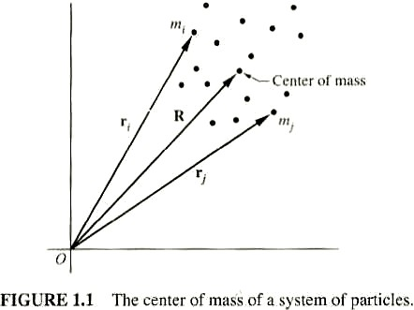
d²(∑_{i}m_{i}r_{i})/dt² = F^{(e)} (3)
Modify (3) by defining R ≡ mass weighted average of position vectors r_{i} .
R ≡ (∑_{i}m_{i}r_{i})/(∑_{i}m_{i}) ≡ (∑_{i}m_{i}r_{i})/M
M ≡ ∑_{i}m_{i} (total mass of
particles in system)
R ≡ Center of mass of the
system (schematic in Figure)
⇒ (3) becomes:
M(d²R/dt²) = MA = M(dV/dt) = (dP/dt) = F^{(e)} (4)
Just like the eqtn of motion for mass M at position R under the force F^{(e)} !

Slide 60
M(d²R/dt²) = F^{(e)} (4)
⇒ Newton’s 2nd Law for a many particle system: The Center of Mass moves as if the total external force were acting on the entire mass of the system concentrated at the Center of Mass!
Corollary: Purely internal forces (assuming they obey Newton’s 3rd Law) have no effect on the motion of the Center of Mass (CM).

Slide 61
Momentum Conservation
MR = (∑_{i}m_{i}r_{i}). Consider: Time derivative (const M):
M(dR/dt) = MV= ∑_{i}m_{i}[(dr_{i})/dt] ≡ ∑_{i}m_{i}v_{i} ≡ ∑_{i}p_{i} ≡ P
(total momentum = momentum of CM)
⇒ Using the definition of P, Newton’s 2nd Law is:
(dP/dt) = F^{(e)} (4´)
Suppose F^{(e)} = 0: ⇒ (dP/dt) = P = 0
⇒ P = constant (conserved)
Conservation Theorem for the Linear Momentum of a System of Particles:
If the total external force, F^{(e)}, is zero, the total linear momentum, P, is conserved.

Slide 62
Angular Momentum
Angular momentum L of a many particle system (sum of angular momenta of each particle): L ≡ ∑_{i}[r_{i} × p_{i}]
Time derivative: L = (dL/dt) = ∑_{i}d[r_{i} × p_{i}]/dt
= ∑_{i}[(dr_{i}/dt) × p_{i}] + ∑_{i}[r_{i} × (dp_{i}/dt)]
(dr_{i}/dt) × p_{i} = v_{i} × (m_{i}v_{i}) = 0
⇒ (dL/dt) = ∑_{i}[r_{i} × (dp_{i}/dt)]
Newton’s 2nd Law: (dp_{i}/dt) = F_{i}^{(e)} + ∑_{j(≠i)} F_{ji}
F_{i}^{(e)} ≡ Total external force on the i ^{th} particle
∑_{j(≠i)} F_{ji} ≡ Total internal force on the i ^{th} particle due to interactions with all other particles (j) in the system
⇒ (dL/dt) = ∑_{i}[r_{i} × F_{i}^{(e)}] + ∑_{i,j(≠i)} [r_{i} × F_{ji}]

Slide 63
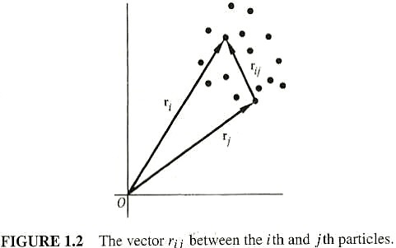
(dL/dt) = ∑_{i}[r_{i} × F_{i}^{(e)}] + ∑_{i,j(≠i)} [r_{i} × F_{ji}] (1)
Consider the 2nd sum & look at each particle pair (i,j). Each term r_{i} × F_{ji} has a corresponding term r_{j} × F_{ij}. Take together & use Newton’s 3rd Law:
⇒ [r_{i}×F_{ji} + r_{j}×F_{ij}] = [r_{i} ×F_{ji} + r_{j} × (-F_{ji})] = [(r_{i} - r_{j}) × F_{ji}]
(r_{i} - r_{j}) ≡ r_{ij} = vector from particle j to particle i. (Figure)

Slide 64
(dL/dt) = ∑_{i}[r_{i} × F_{i}^{(e)}] + (½)∑_{i,j(≠i)}[r_{ij} × F_{ji}] (1)
Assumption: Internal forces are Central Forces: Directed the along lines joining the particle pairs
(≡ The “Strong” Law of Action and Reaction)
⇒ r_{ij} || F_{ji} for each (i,j) & [r_{ij} × F_{ji}] = 0 for each (i,j)!
⇒ 2nd term in (1) is (½)∑_{i,j(≠i)} [r_{ij} × F_{ji}] = 0
↑
To Prevent Double Counting!

Slide 65
⇒ (dL/dt) = ∑_{i}[r_{i} × F_{i}^{(e)}] (2)
Total external torque on particle i:
N_{i}^{(e)} ≡ r_{i} × F_{i}^{(e)}
(2) becomes:
(dL/dt) = N^{(e)} (2´)
N^{(e)} ≡ ∑_{i}[r_{i} × F_{i}^{(e)}] = ∑_{i}N_{i}^{(e)}
= Total external torque on the system

Slide 66
(dL/dt) = N^{(e)} (2´)
⇒ Newton’s 2nd Law (rotational motion) for a many particle system: The time derivative of the total angular momentum is equal to the total external torque.
Suppose N^{(e)} = 0: ⇒ (dL/dt) = L = 0
⇒ L = constant (conserved)
Conservation Theorem for the Total Angular Momentum of a Many Particle System:
If the total external torque, N^{(e)}, is zero, then (dL/dt) = 0 and the total angular momentum, L, is conserved.

Slide 67
(dL/dt) = N^{(e)}. A vector equation! Holds component by component. ⇒ Angular momentum conservation holds component by component. For example, if N_{z}^{(e)} = 0, L_{z} is conserved.
Linear & Angular Momentum Conservation Laws:
Conservation of Linear Momentum holds if internal forces obey the “Weak” Law of Action and Reaction: Only Newton’s 3rd Law F_{ji} = - F_{ij} is required to hold!
Conservation of Angular Momentum holds if internal forces obey the “Strong” Law of Action and Reaction: Newton’s 3rd Law F_{ji} = - F_{ij} holds, PLUS the forces must be Central Forces, so that r_{ij} || F_{ji} for each (i,j)!
Valid for many common forces (gravity, electrostatic). Not valid for some (magnetic forces, etc.).

Slide 68
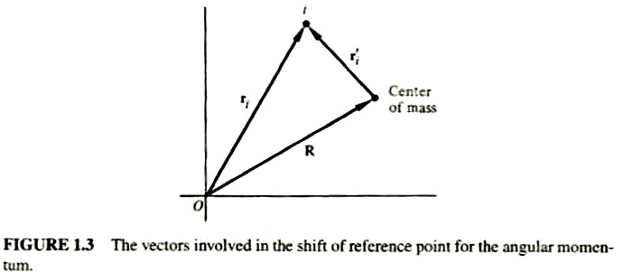
Center of Mass & Relative Coordinates
More on angular momentum. Search for an analogous relation to what we had for linear momentum:
P = M(dR/dt) = MV
Want: Total momentum = Momentum of CM = Same as if entire mass of system were at CM.
Start with total the angular momentum: L ≡ ∑_{i}[r_{i} × p_{i}]
R ≡ CM coordinate (origin O). For particle i define:
r_{i}´ ≡ r_{i} - R = relative coordinate vector from CM to particle i (Figure)

Slide 69
r_{i} = r_{i}´ + R
Time derivative: (dr_{i}/dt) = (dr_{i}´/dt) + (dR/dt) or:
v_{i} = v_{i}´ + V , V ≡ CM velocity relative to O
v_{i}´ ≡ velocity of particle i relative to CM. Also:
p_{i} ≡ m_{i}v_{i} ≡ momentum of particle i relative to O
Put this into angular momentum:
L = ∑_{i}[r_{i} × p_{i}] = ∑_{i}[(r_{i}´ + R) × m_{i}(v_{i}´ +V)]
Manipulation: (using m_{i}v_{i}´= d(m_{i}r_{i}´)/dt )
L = R × ∑_{i}(m_{i})V + ∑_{i}[r_{i}´ × (m_{i}v_{i}´)] +
∑_{i}(m_{i}r_{i}´) × V + R × d[∑_{i}(m_{i}r_{i}´)]/dt
Note: ∑_{i}(m_{i}r_{i}´) defines the CM coordinate with respect to the CM & is thus zero!! ∑_{i}(m_{i}r_{i}´) ≡ 0 !
⇒ The last 2 terms are zero!

Slide 70
⇒ L = R × ∑_{i}(m_{i})V + ∑_{i}[r_{i}´ × (m_{i}v_{i}´)] (1)
Note that ∑_{i}(m_{i}) ≡ M = total mass & also
m_{i}v_{i}´ ≡ p_{i}´ = momentum of particle i relative to the CM
⇒ L = R×(MV)+ ∑_{i}[r_{i}´ × p_{i}´] = R×P + ∑_{i}[r_{i}´×p_{i}´] (2)
The total angular momentum about point O = the angular momentum of the motion of the CM + the angular momentum of motion about the CM
(2) ⇒ In general, L depends on the origin O, through the vector R. Only if the CM is at rest with respect to O, will the first term in (2) vanish. Then & only then will L be independent of the point of reference. Then & only then will L = angular momentum about the CM

Slide 71
Work & Energy
The work done by all forces in changing the system from configuration 1 to configuration 2:
W₁₂ ≡ ∑_{i} ∫F_{i}•ds_{i} (limits: from 1 to 2) (1)
As before: F_{i} = F_{i}^{(e)} + ∑_{j}F_{ji}
⇒ W₁₂ = ∑_{i} ∫F_{i}^{(e)} •ds_{i} + ∑_{i,j(≠i)} ∫ F_{ji} •ds_{i} (2)
Work with (1) first:
Newton’s 2nd Law ⇒ F_{i} = m_{i}(dv_{i}/dt). Also: ds_{i} = v_{i}dt
F_{i}•ds_{i} = m_{i}(dv_{i}/dt)•ds_{i} = m_{i}(dv_{i}/dt)•v_{i}dt
= m_{i}v_{i}dv_{i} = d[(½)m_{i}(v_{i})²]
⇒ W₁₂ = ∑_{i} ∫ d[(½)m_{i}(v_{i})²] ≡ T₂ - T₁
where T ≡ (½)∑_{i}m_{i}(v_{i})² = Total System Kinetic Energy

Slide 72
Work-Energy Principle
W₁₂ = T₂ - T₁ = ΔT
The total Work done = The change in kinetic energy
(Work-Energy Principle or Work-Energy Theorem)
Total Kinetic Energy: T ≡ (½)∑_{i}m_{i}(v_{i})²
Another useful form: Use transformation to CM & relative coordinates: v_{i} = V + v_{i}´ , V ≡ CM velocity relative to O, v_{i}´ ≡ velocity of particle i relative to CM.
⇒ T ≡ (½)∑_{i}m_{i}(V+ v_{i}´)•(V + v_{i}´)
T = (½)(∑_{i}m_{i})V² + (½)∑_{i}m_{i}(v_{i}´)² + V•∑_{i}m_{i} v_{i}´
Last term: V•d(∑_{i}m_{i} r_{i}´)/dt. From the angular momentum discussion: ∑_{i} m_{i} r_{i}´ = 0 ⇒ The last term is zero!
⇒ Total KE: T = (½)MV² + (½)∑_{i}m_{i}(v_{i}´)²

Slide 73
Total KE
T = (½)MV² + (½)∑_{i} m_{i}(v_{i}´)²
The total Kinetic Energy of a many particle system is equal to the Kinetic Energy of the CM plus the Kinetic Energy of motion about the CM.

Slide 74
Work & PE
2 forms for work:
W₁₂= ∑_{i} ∫F_{i}•ds_{i} = T₂ - T₁ = ΔT (just showed!) (1)
W₁₂ = ∑_{i} ∫F_{i}^{(e)} •ds_{i} + ∑_{i,j(≠i)} ∫F_{ji} •ds_{i} (2)
Use (2) with Conservative Force Assumptions:
1. External Forces: ⇒ Potential functions V_{i}(r_{i}) exist such that (for each particle i): F_{i}^{(e)} = - ∇_{i}V_{i}(r_{i})
2. Internal Forces: ⇒ Potential functions V_{ij} exist such that (for each particle pair i,j): F_{ij} = - ∇_{i}V_{ij}
2´. Strong Law of Action-Reaction: ⇒ Potential functions V_{ij}(r_{ij}) are functions only of distance
r_{ij} = |r_{i} - r_{j}| between i & j & the forces lie along line joining them (Central Forces!): V_{ij} = V_{ij}(r_{ij})
⇒ F_{ij} = - ∇_{i}V_{ij} = + ∇_{j}V_{ij} = -F_{ji} = (r_{i} - r_{j})f(r_{ij})
f is a scalar
←function!

Slide 75
Conservative external forces:
⇒ ∑_{i} ∫F_{i}^{(e)} •ds_{i} = - ∑_{i} ∫ ∇_{i}V_{i}•ds_{i} = - ∑_{i}(V_{i})₂ + ∑_{i}(V_{i})₁ Or: ∑_{i} ∫F_{i}^{(e)} •ds_{i} = (V^{(e)})₁ - (V^{(e)})₂
Where: V^{(e)} ≡ ∑_{i}V_{i} = total PE associated with external forces.
Conservative internal forces: Write (sum over pairs)
⇒ ∑_{i,j(≠i)} ∫F_{ji}•ds_{i} = (½)∑_{i,j(≠i)} ∫[F_{ji}•ds_{i} + F_{ij}•ds_{j}]
= - (½)∑_{i,j(≠i)} ∫[∇_{i}V_{ij}•ds_{i} + ∇_{j}V_{ij}•ds_{j}]
Note: ∇_{i}V_{ij} = - ∇_{j}V_{ij} = ∇_{ij}V_{ij} (∇_{ij} ≡ grad with respect to r_{ij})
Also: ds_{i} - ds_{j} = dr_{ij}
⇒ ∑_{i,j(≠i)} ∫F_{ji}•ds_{i} = - (½)∑_{i,j(≠i)} ∫ ∇_{ij}V_{ij}•dr_{ij}
= - (½)∑_{i,j(≠i)}(V_{ij})₂ + (½)∑_{i,j(≠i)}(V_{ij})₁
do integral!!

Slide 76
Conservative internal (Central!) forces:
∑_{i,j(≠i)} ∫F_{ji}•ds_{i} = - (½)∑_{i,j(≠i)}(V_{ij})₂ + (½)∑_{i,j(≠i)}(V_{ij})₁
or: ∑_{i,j(≠i)} ∫F_{ji}•ds_{i} = (V^{(I)})₁ - (V^{(I)})₂
Where: V^{(I)} ≡ (½)∑_{i,j(≠i)}V_{ij} = Total PE associated with internal forces.
For conservative external forces & conservative, central internal forces, it is possible to define a potential energy function for the system:
V ≡ V^{(e)} + V^{(I)} ≡ ∑_{i}V_{i} + (½)∑_{i,j(≠i)}V_{ij}

Slide 77
Conservation of Mechanical Energy
For conservative external forces & conservative, central internal forces:
The total work done in a process is:
W₁₂ = V₁ - V₂ = - ΔV
with V ≡ V^{(e)} + V^{(I)} ≡ ∑_{i}V_{i} + (½)∑_{i,j(≠i)} V_{ij}
In general
W₁₂ = T₂ - T₁ = ΔT
Combining ⇒ V₁ - V₂ = T₂ - T₁ or ΔT + ΔV = 0
or T₁ + V₁ = T₂ + V₂
or E = T + V = constant
E = T + V ≡ Total Mechanical Energy
(or just Total Energy)

Slide 78
Energy Conservation
ΔT + ΔV = 0
or T₁ + V₁ = T₂ + V₂
or E = T + V = constant (conserved)
Energy Conservation Theorem for a Many Particle System:
If only conservative external forces & conservative,
central internal forces are acting on a system, then
the total mechanical energy of the system,
E = T + V, is conserved.

Slide 79
Consider the potential energy:
V ≡ V^{(e)} + V^{(I)} ≡ ∑_{i}V_{i} + (½)∑_{i,j(≠i)} V_{ij}
2nd term V^{(I)} ≡ (½)∑_{i,j(≠i)} V_{ij} ≡ Internal Potential Energy of the System. This is generally non-zero & might vary with time.
Special Case: Rigid Body: System of particles in which distances r_{ij} are fixed (do not vary with time).
⇒ dr_{ij} are all ⊥ r_{ij} & thus to internal forces F_{ij}
⇒ F_{ij} do no work. ⇒ V^{(I)} = constant
Since V is arbitrary to within an additive constant, we can ignore V^{(I)} for rigid bodies only.

Slide 80
Constraints

Slide 81
Constraints
Discussion up to now ⇒ All mechanics is reduced to solving a set of simultaneous, coupled, 2nd order differential eqtns which come from Newton’s 2nd Law applied to each mass individually:
(dp_{i}/dt) = m_{i}(d²r_{i}/dt²) = F_{i}^{(e)} + ∑_{j}F_{ji}
⇒ Given forces & initial conditions, problem is reduced to pure math!
Oversimplification!! Many systems have CONSTRAINTS which limit their motion.
Example: Rigid Body. Constraints keep r_{ij} = constant.
Example: Particle motion on surface of sphere.

Slide 82
Types of Constraints
In general, constraints are expressed as a mathematical relation or relations between particle coordinates & possibly the time.
Eqtns of constraint are relations like:
f(r₁,r₂,r₃,…r_{N},t) = 0
Constraints which may be expressed as above:
≡ Holonomic Constraints.
Example of Holonomic Constraint: Rigid body. Constraints on coordinates are of the form:
(r_{i} - r_{j})² - (c_{ij})² = 0
c_{ij} = some constant

Slide 83
Constraints not expressible as f(r_{i},t) = 0
≡ Non-Holonomic Constraints
Example of Non-Holonomic Constraint: Particle confined to surface of rigid sphere, radius a: r² - a² ≥ 0
Time dependent constraints:
≡ Rhenomic or Rhenomous Constraints.
If constraint eqtns don’t explicitly contain time: ≡ Fixed or Scleronomic or Scleronomous Constraints.

Slide 84
Difficulties constraints introduce in problems:
1. Coordinates r_{i} are no longer all independent. Connected by constraint eqtns.
2. To apply Newton’s 2nd Law, need TOTAL force acting on each particle. Forces of constraint aren’t always known or easily calculated.
⇒ With constraints, it’s often difficult to directly apply Newton’s 2nd Law.
Put another way: Forces of constraint are often among the unknowns of the problem!

Slide 85
Generalized Coordinates
To handle the 1st difficulty (with holonomic constraints), introduce Generalized Coordinates.
Alternatives to usual Cartesian coordinates.
System (3d) N particles & no constraints.
⇒ 3N degrees of freedom
(3N independent coordinates)
With k holonomic constraints, each expressed by eqtn of form:
f_{m}(r₁,r₂,r₃,…r_{N},t) = 0 (m = 1, 2, … k)
⇒ 3N - k degrees of freedom
(3N - k independent coordinates)

Slide 86
General mechanical system with s = 3N - k degrees of freedom (3N - k independent coordinates).
Introduce s = 3N - k independent Generalized Coordinates to describe system:
Notation: q₁,q₂, … Or: q ( = 1,2,… s)
In principle, can always find relations between generalized coordinates & Cartesian (vector) coordinates of form: r_{i} = r_{i} (q₁,q₂,q₃,.,t) (i = 1,2,3,…N)
These are transformation eqtns from the set of coordinates (r_{i} ) to the set (q) . They are parametric representations of (r_{i} )
In principle, can combine with k constraint eqtns to obtain inverse relations q = q(r₁,r₂,r₃,..t) ( = 1,2,… s)

Slide 87
Generalized Coordinates ≡ Any set of s quantities which completely specifies the state of the system (for a system with s degrees of freedom).
These s generalized coords need not be Cartesian! Can choose any set of s coordinates which completely describes state of motion of system. Depending on problem:
Could have s curvilinear (spherical, cylindrical, ..) coords
Could choose mixture of rectangular coords (m = # rectangular coords) & curvilinear (s - m = # curvilinear coords)
The s generalized coords needn’t have units of length! Could be dimensionless or have (almost) any units.

Slide 88
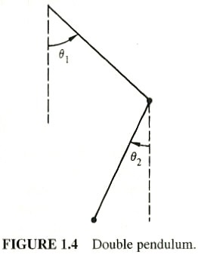
Generalized coords, q will (often) not divide into groups of 3 that can be associated with vectors.
Example: Particle on sphere surface: A convenient choice of
q = latitude & longitude.
Example: Double pendulum:
A convenient choice of
q = θ₁ & θ₂ (Figure) →

Slide 89
Sometimes, it’s convenient & useful to use Generalized Coords (non-Cartesian) even in systems with no constraints.
Example: Central force field problems:
V = V(r), it makes sense to use spherical coords!
Generalized coords need not be orthogonal coordinates & need not be position coordinates.

Slide 90
Non-Holonomic constraint:
⇒ Eqtns expressing constraint can’t be used to eliminate dependent coordinates.
Example: Object rolling without slipping on a rough surface. Coordinates needed to describe motion: Angular coords to specify body orientation + coords to describe location of point of contact of body & surface. Constraint of rolling ⇒ Connects 2 coord sets: They aren’t independent. BUT, # coords cannot be reduced by the constraint, because cannot express rolling condition as eqtn between coords! Instead, (can show) rolling constraint is condition on the velocities: a differential eqtn which can be integrated only after solution to problem is known!

Slide 91
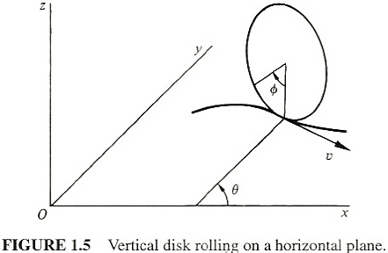
Example: Rolling Constraint
Disk, radius a, constrained to be vertical, rolling on the horizontal (xy) plane. Figure:
Generalized coords: x, y of point of contact of disk with plane + θ = angle between disk axis & x-axis + φ = angle of rotation about disk axis

Slide 92
Constraint: Velocity v of
disk center is related to
angular velocity (dφ/dt)
of disk rotation:
v = a(dφ/dt) (1)
Also Cartesian components of v:
v_{x} = (dx/dt) = v sinθ, v_{y} = (dy/dt) = -v cosθ (2)
Combine (1) & (2) (multiplying through by dt):
⇒ dx - a sinθ dφ = 0 dy + a cosθ dφ = 0
Neither can be integrated without solving the problem! That is, a function f(x,y,θ,φ) = 0 cannot be found. Physical argument that φ must be indep of x,y,θ: See pp. 15 & 16

Slide 93
Non-Holonomic constraints can also involve higher order derivatives or inequalities.
Holonomic constraints are preferred, since easiest to deal with. No general method to treat problems with Non-Holonomic constraints. Treat on case-by-case basis.
In special cases of Non-Holonomic constraints, when constraint is expressed in differential form (as in example), can use method of Lagrange multipliers along with Lagrange’s eqtns (later).
Authors argue, except for some macroscopic physics textbook examples, most problems of practical interest to physicists are microscopic & the constraints are holonomic or do not actually enter the problem.

Slide 94
Difficulties constraints introduce:
1. Coordinates r_{i} are no longer all independent. Connected by constraint eqtns.
Have now thoroughly discussed this problem!
2. To apply Newton’s 2nd Law, need the TOTAL force acting on each particle. Forces of constraint are not always known or easily calculated.
⇒ With constraints, it’s often difficult to directly apply Newton’s 2nd Law.
Put another way: Forces of constraint are often among the unknowns of the problem! To address this, long ago, people reformulated mechanics. Lagrangian & Hamiltonian formulations. No direct reference to forces of constraint.

Slide 95
D’Alembert’s Principle & Lagrange’s Equations
Virtual (infinitesimal) displacement ≡ Change in the system configuration as result of an arbitrary infinitesimal change of coordinates δr_{i}, consistent with the forces & constraints imposed on the system at a given time t.
“Virtual” distinguishes it from an actual displacement dr_{i}, occurring in small time interval dt (during which forces & constraints may change)

Slide 96
Consider the system at equilibrium: The total force on each particle is F_{i} = 0. Virtual work done by F_{i} in displacement δr_{i}:
δW_{i} = F_{i}•δr_{i} = 0. Sum over i:
⇒ δW = ∑_{i}F_{i}•δr_{i} = 0.
Decompose F_{i} into applied force F_{i}^{(a)} & constraint force f_{i}: F_{i} = F_{i}^{(a)} + f_{i}
⇒ δW = ∑_{i} (F_{i}^{(a)} + f_{i} )•δr_{i} ≡ δW^{(a)} + δW^{(c)} = 0
Special case (often true, see text discussion): Systems for which the net virtual work due to constraint forces is zero: ∑_{i}f_{i}•δr_{i} ≡ δW^{(c)} = 0

Slide 97
Principle of Virtual Work
⇒ Condition for system equilibrium: Virtual work
due to APPLIED forces vanishes:
δW^{(a)} = ∑_{i}F_{i}^{(a)}•δr_{i} = 0 (1)
≡ Principle of Virtual Work
Note: In general coefficients of δr_{i} , F_{i}^{(a)} ≠ 0 even though ∑_{i}F_{i}^{(a)}•δr_{i} = 0 because δr_{i} are not independent, but connected by constraints.
In order to have coefficients of δr_{i} = 0, must transform Principle of Virtual Work into a form involving virtual displacements of generalized coordinates q , which are independent. (1) is good since it does not involve constraint forces f_{i} . But so far, only statics. Want to treat dynamics!

Slide 98
D’Alembert’s Principle
Dynamics: Start with Newton’s 2nd Law for particle i: F_{i} = (dp_{i}/dt) Or: F_{i} - (dp_{i}/dt) = 0
⇒ Can view system particles as in “equilibrium” under a force
= actual force + “reversed effective force” = -(dp/dt)
Virtual work done is
δW = ∑_{i}[F_{i} - (dp_{i}/dt)]•δr_{i} = 0
Again decompose F_{i}: F_{i} = F_{i}^{(a)} + f_{i}
⇒ δW = ∑_{i}[F_{i}^{(a)} - (dp_{i}/dt) + f_{i} ]•δr_{i} = 0
Again restrict consideration to special case: Systems for which the net virtual work due to constraint forces is zero: ∑_{i} f_{i}•δr_{i} ≡ δW^{(c)} = 0

Slide 99
⇒ δW = ∑_{i}[F_{i} - (dp_{i}/dt)]•δr_{i} = 0 (2)
≡ D’Alembert’s Principle
Dropped the superscript (a)!
Transform (2) to an expression involving virtual displacements of q (which, for holonomic constraints, are indep of each other). Then, by linear independence, the coefficients of the δq = 0

Slide 100
δW = ∑_{i}[F_{i} - (dp_{i}/dt)]•δr_{i} = 0 (2)
Much manipulation follows! Only highlights here!
Transformation eqtns:
r_{i} = r_{i}(q₁,q₂,q₃,.,t) (i = 1,2,3,…n)
Chain rule of differentiation (velocities):
v_{i} ≡ (dr_{i}/dt) = ∑_{k}(∂r_{i}/∂q_{k})(dq_{k}/dt) + (∂r_{i}/∂t) (a)
Virtual displacements δr_{i} are connected to virtual
displacements δq: δr_{i} = ∑_{j} (∂r_{i}/∂q_{j})δq_{j} (b)

Slide 101
Generalized Forces
1st term of (2) (Combined with (b)):
∑_{i} F_{i} •δr_{i} = ∑_{i,j} F_{i} •(∂r_{i}/∂q_{j})δq_{j} ≡ ∑_{j}Q_{j}δq_{j} (c)
Define Generalized Force (corresponding to Generalized Coordinate q_{j}): Q_{j} ≡ ∑_{i}F_{i}•(∂r_{i}/∂q_{j})
Generalized Coordinates q_{j} need not have units of length!
⇒ Corresponding Generalized Forces Q_{j} need not have units of force!
For example: If q_{j} is an angle, corresponding Q_{j} will be a torque!

Slide 102
2nd term of (2) (using (b) again):
∑_{i}(dp_{i}/dt)•δr_{i} = ∑_{i}[m_{i} (d²r_{i}/dt²)•δr_{i} ] =
∑_{i,j}[m_{i} (d²r_{i}/dt²)•(∂r_{i}/∂q_{j})δq_{j}] (d)
Manipulate with (d): ∑_{i}[m_{i} (d²r_{i}/dt²)•(∂r_{i}/∂q_{j})] =
∑_{i}[d{m_{i}(dr_{i}/dt)•(∂r_{i}/∂q_{j})}/dt] – ∑_{i}[m_{i}(dr_{i}/dt)•d{(∂r_{i}/∂q_{j})}/dt]
Also: d{(∂r_{i}/∂q_{j})}/dt = ∂{dr_{i}/dt}/∂q_{j} ≡ (∂v_{i}/∂q_{j})
Use (a): (∂v_{i}/∂q_{j}) = ∑_{k}(∂²r_{i}/∂q_{j}∂q_{k})(dq_{k}/dt) + (∂²r_{i}/∂q_{j}∂t)
From (a): (∂v_{i}/∂q_{j}) = (∂r_{i}/∂q_{j})
So: ∑_{i}[m_{i} (d²r_{i}/dt²)•(∂r_{i}/∂q_{j})]
= ∑_{i}[d{m_{i}v_{i}•(∂v_{i}/∂q_{j})}/dt] - ∑_{i}[m_{i}v_{i}•(∂v_{i}/∂q_{j})]

Slide 103
More manipulation ⇒ (2) is: ∑_{i}[F_{i}-(dp_{i}/dt)]•δr_{i} = 0
∑_{j}{d[∂(∑_{i} (½)m_{i}(v_{i})²)/∂q_{j}]/dt - ∂(∑_{i}(½)m_{i}(v_{i})²)/∂q_{j} - Q_{j}}δq_{j} = 0
System kinetic energy is: T ≡ (½)∑_{i}m_{i}(v_{i})²
⇒ D’Alembert’s Principle becomes
∑_{j}{(d[∂T/∂q_{j}]/dt) - (∂T/∂q_{j}) - Q_{j}}δq_{j} = 0 (3)
Note: If q_{j} are Cartesian coords, (∂T/∂q_{j}) = 0
⇒ In generalized coords, (∂T/∂q_{j}) comes from the curvature of the q_{j}. (Example: Polar coords, (∂T/∂θ) becomes the centripetal acceleration).
So far, no restriction on constraints except that they do no work under virtual displacement. q_{j} are any set.
Special case: Holonomic Constraints ⇒ It’s possible to find sets of q_{j} for which each δq_{j} is independent.
⇒ Each term in (3) is separately 0!

Slide 104
Holonomic constraints ⇒ D’Alembert’s Principle:
(d[∂T/∂q_{j}]/dt) - (∂T/∂q_{j}) = Q_{j} (4)
(j = 1,2,3, … n)
Special case: A Potential Exists ⇒ F_{i} = - ∇_{i}V
Needn’t be conservative! V could be a function of t!
⇒ Generalized forces have the form
Q_{j} ≡ ∑_{i} F_{i}•(∂r_{i}/∂q_{j}) = - ∑_{i} ∇_{i}V•(∂r_{i}/∂q_{j}) ≡ - (∂V/∂q_{j})
Put this in (4): (d[∂T/∂q_{j}]/dt) - (∂[T-V]/∂q_{j}) = 0
So far, V doesn’t depend on the velocities q_{j}
⇒ (d/dt)[∂(T-V)/∂q_{j}] - ∂(T-V)/∂q_{j} = 0 (4´)

Slide 105
Lagrange’s Equations
Define: The Lagrangian L of the system:
L ≡ T - V
⇒ Can write D’Alembert’s Principle as:
(d/dt)[(∂L/∂q_{j})] - (∂L/∂q_{j}) = 0 (5) (j = 1,2,3, … n)
(5) ≡ Lagrange’s Equations

Slide 106
Lagrange’s Equations
Lagrangian: L ≡ T - V
Lagrange’s Eqtns:
(d/dt)[(∂L/∂q_{j})] - (∂L/∂q_{j}) = 0 (j = 1,2,3, … n)
Note: L is not unique, but is arbitrary to within the addition of a derivative (dF/dt). F = F(q,t) is any differentiable function of q’s & t.
That is, if we define a new Lagrangian L´
L´= L + (dF/dt)
It is easy to show that L´ satisfies the same Lagrange’s Eqtns (above).

Slide 107
Velocity-Dependent Potentials & the Dissipation Function
Non-conservative forces? It’s still possible, in a Special Case, to use Lagrange’s Eqtns unchanged, provided a Generalized or Velocity-Dependent Potential U = U(q_{j},q_{j}) exists, where the generalized forces Q_{j} are obtained as:
Q_{j} ≡ - (∂U/∂q_{j}) + (d/dt)[(∂U/∂q_{j})]
The Lagrangian is now: L ≡ T - U & Lagrange’s Eqtns are still:
(d/dt)[(∂L/∂q_{j})] - (∂L/∂q_{j}) = 0 (j = 1,2,3, … n)
A very important application: Electromagnetic forces on moving charges.

Slide 108
Electromagnetic Force Problem
Particle, mass m, charge q moving with velocity v in combined electric (E) & magnetic (B) fields.
Lorentz Force (SI units!):
F = q[E + (v × B)] (1)
E&M results that you should know!
E = E(x,y,z,t) & B = B(x,y,z,t) are derivable from a scalar potential φ = φ(x,y,z,t) and a vector potential A = A(x,y,z,t) as:
E ≡ - ∇φ - (∂A/∂t) (2)
B ≡ ∇ × A (3)

Slide 109
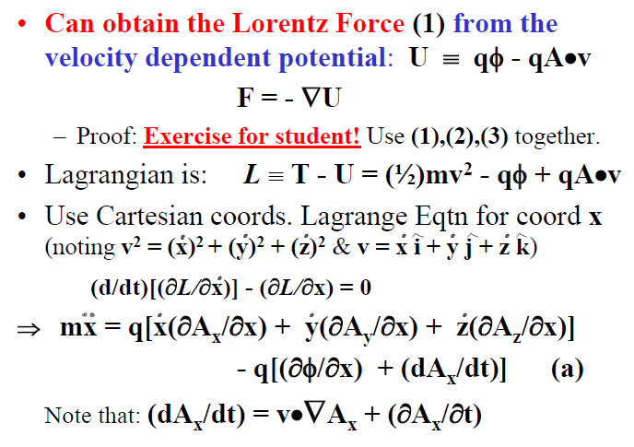

Slide 110
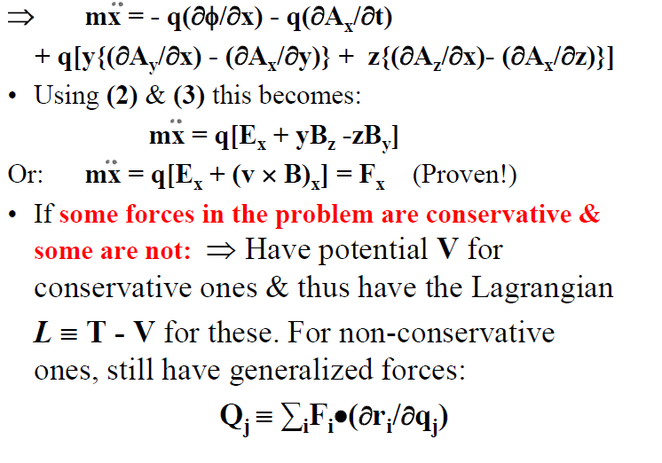

Slide 111
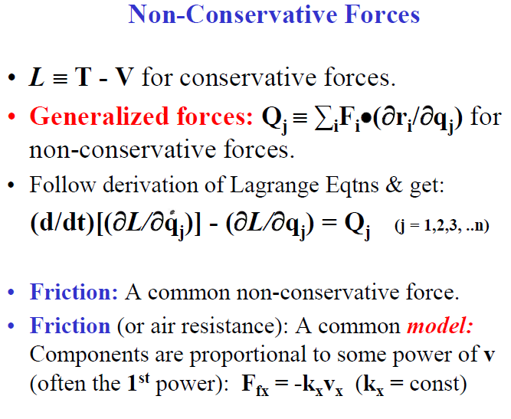

Slide 112
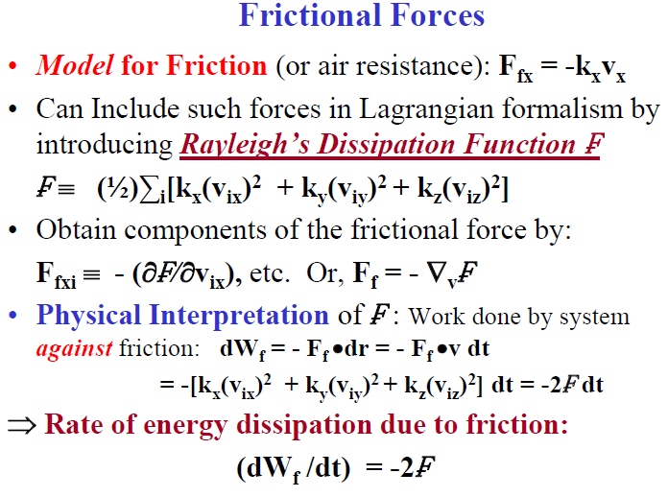

Slide 113
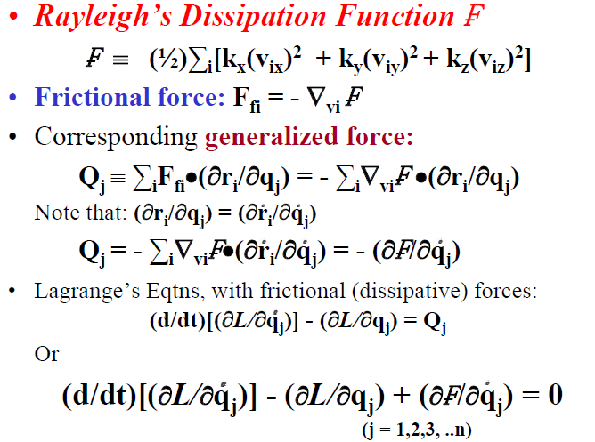

Slide 114
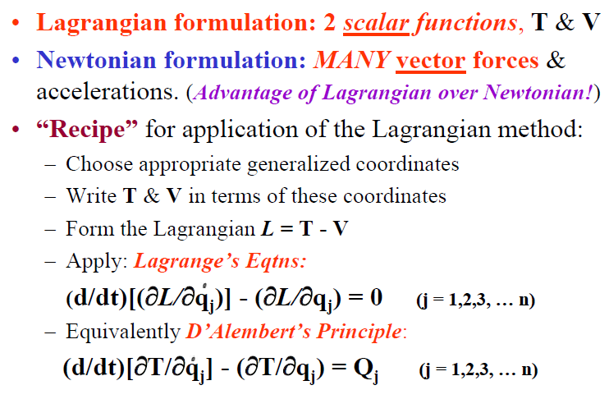
Simple Applications of the Lagrangian Formulation

Slide 115
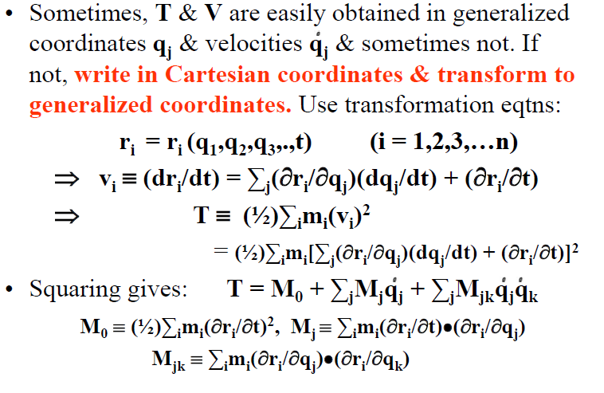

Slide 116
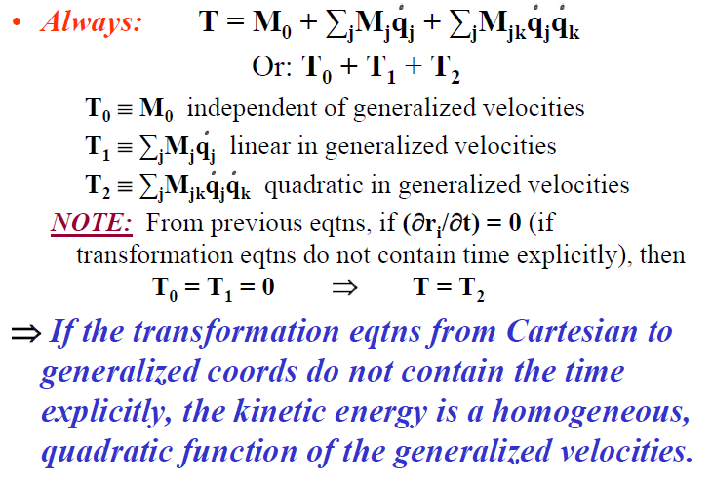

Slide 117
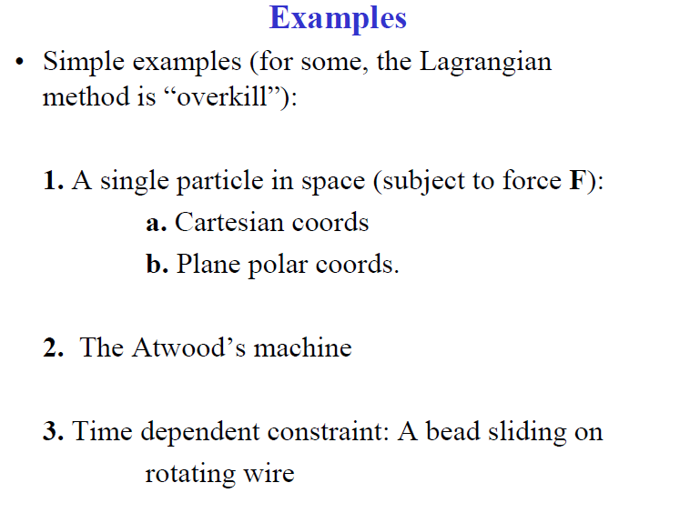

Slide 118
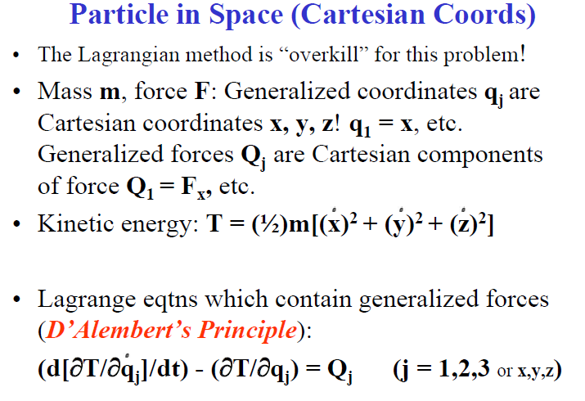

Slide 119
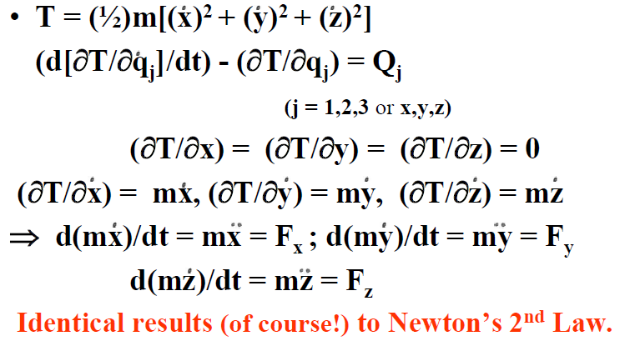

Slide 120
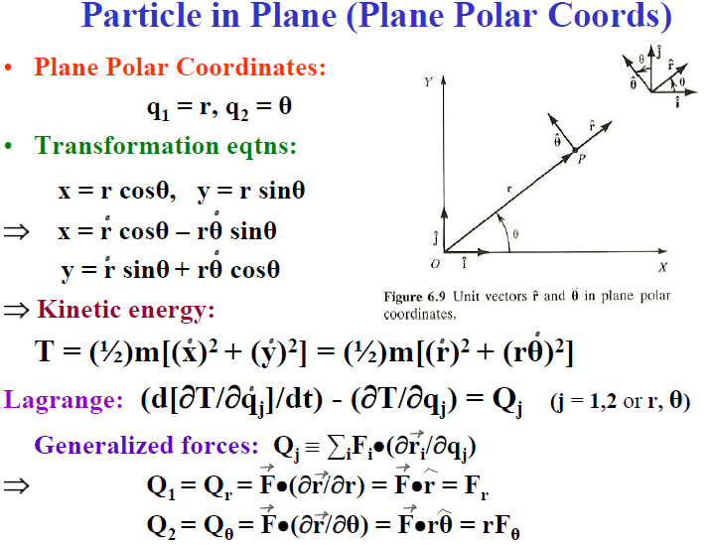

Slide 121
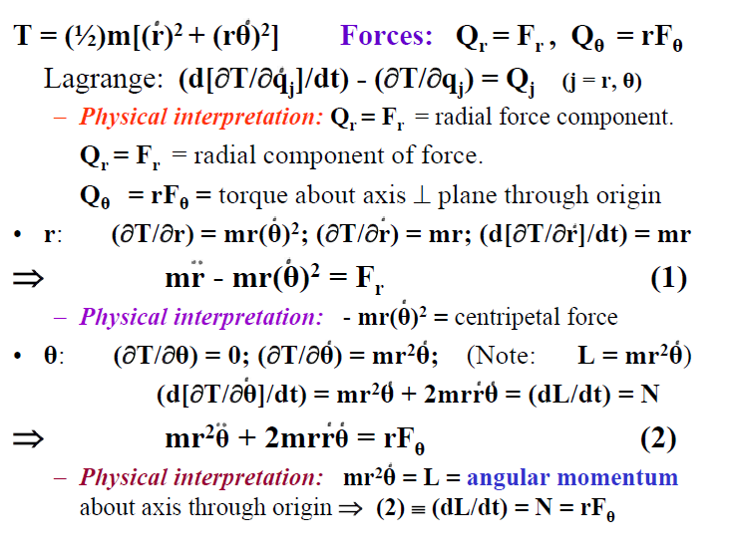

Slide 122
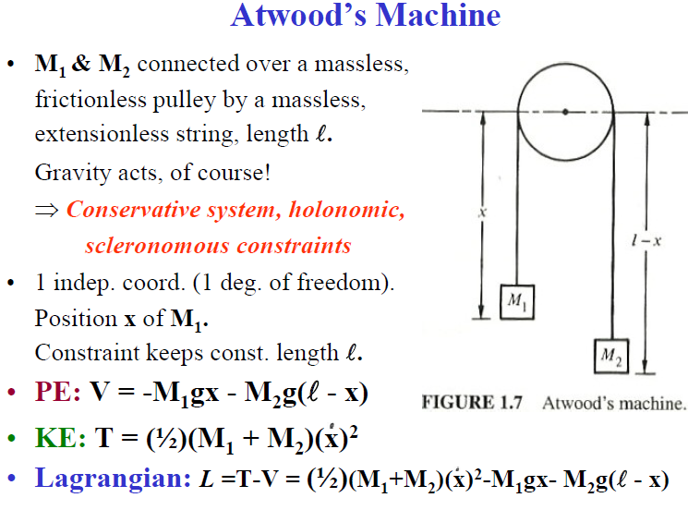

Slide 123
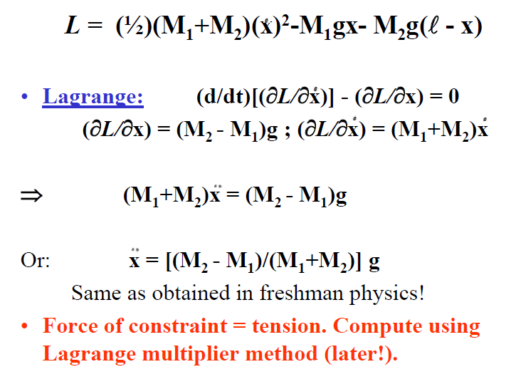

Slide 124
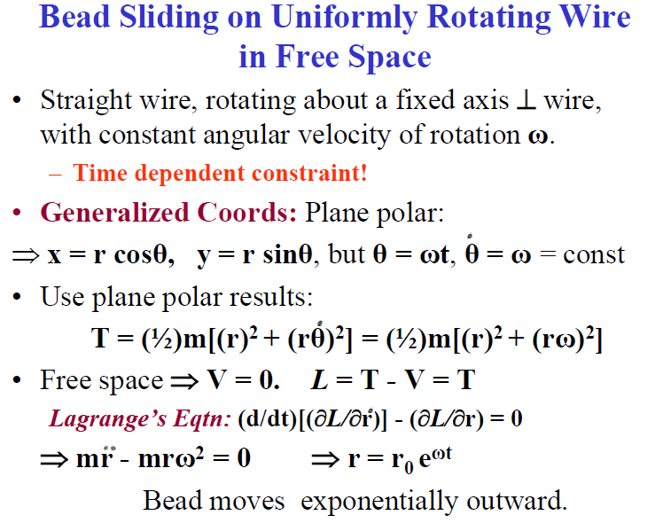

Slide 125
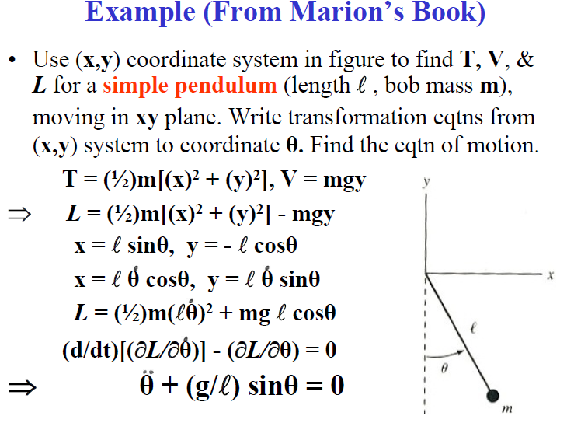

Slide 126
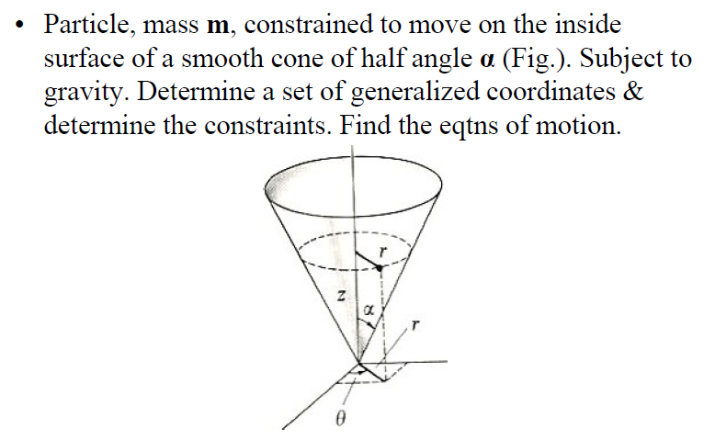

Slide 127
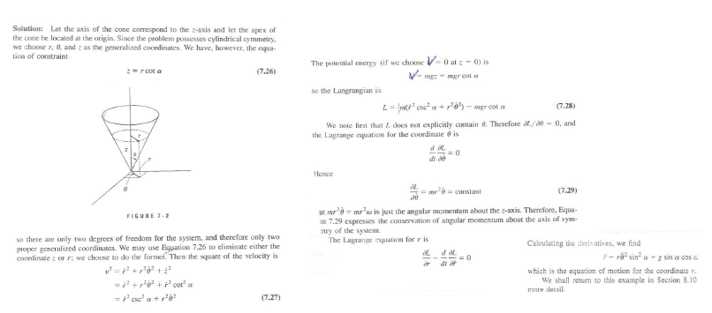

Slide 128
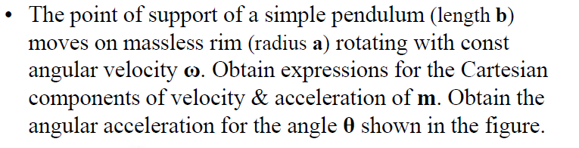
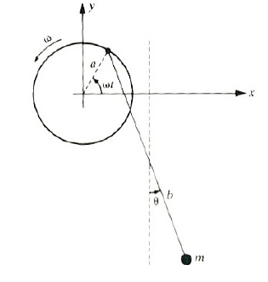

Slide 129
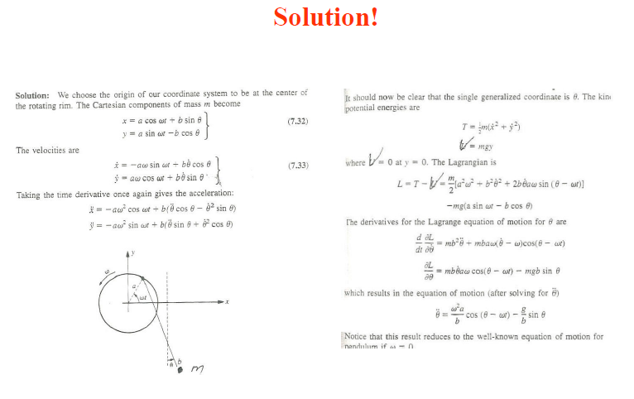

Slide 130
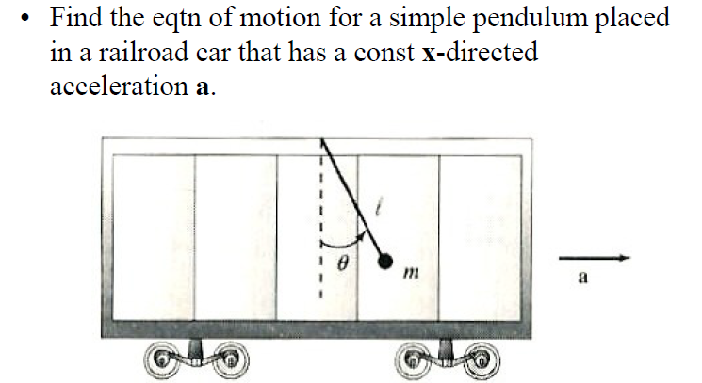

Slide 131
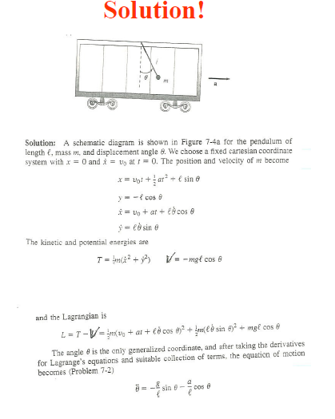

Slide 132
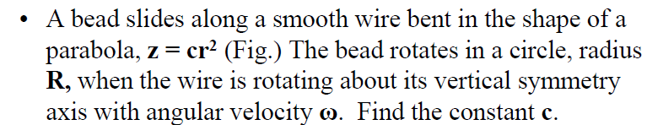
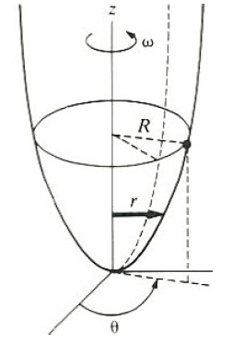

Slide 133
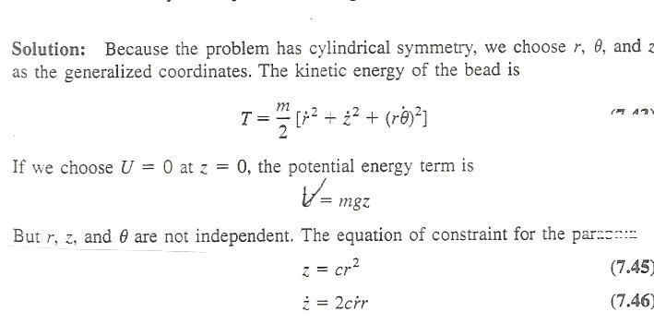
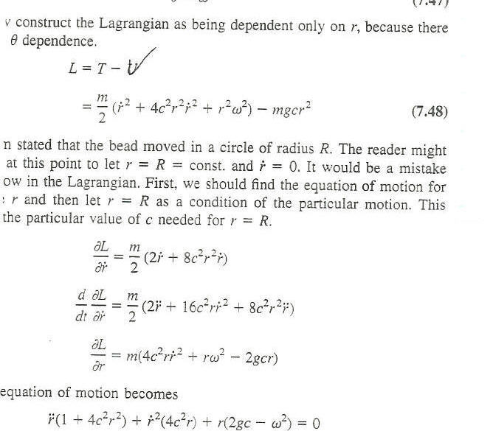
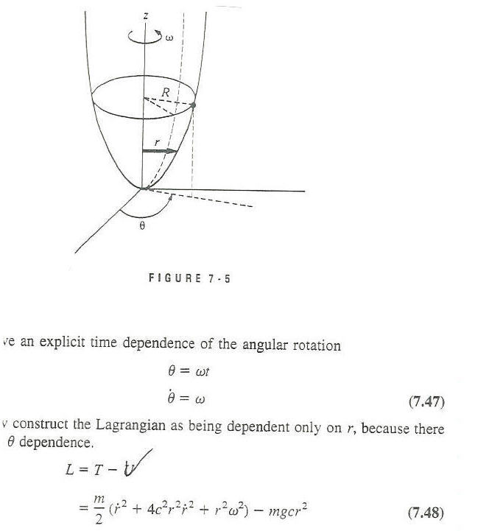
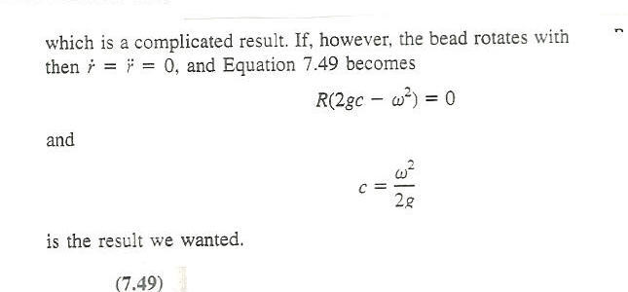
Solution!

Slide 134
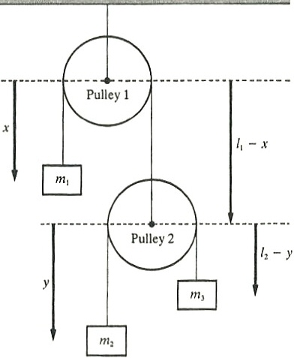
Consider the double pulley system shown. Use the coordinates indicated & determine the eqtns of motion.

Slide 135
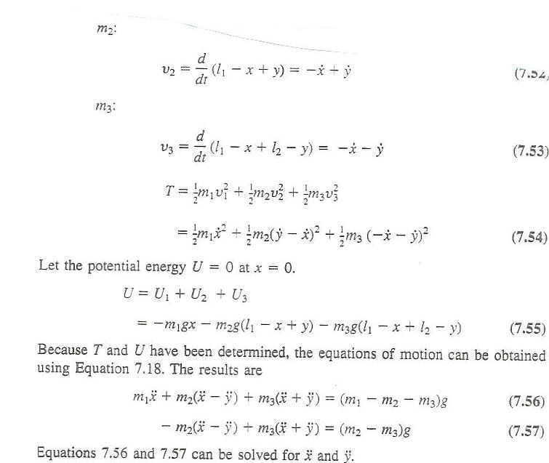
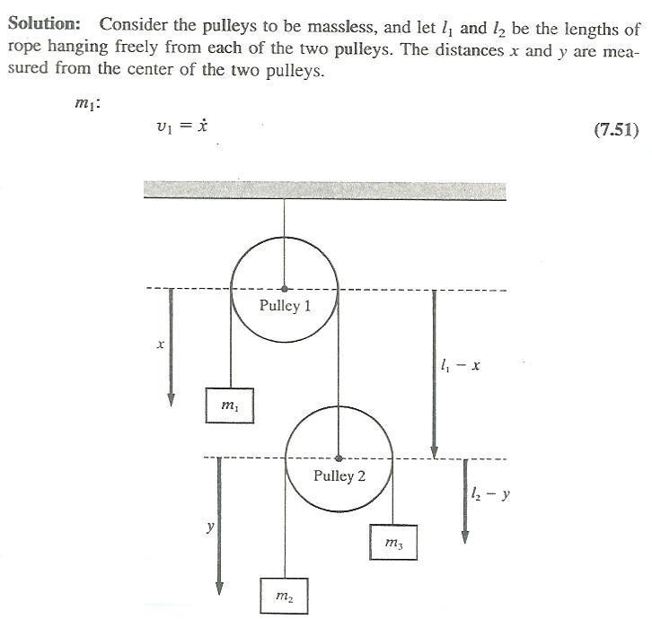
Solution!

Slide 136
Variational Principles & Lagrange’s Eqtns
Hamilton’s Principle
Our derivation of Lagrange’s Eqtns from D’Alembert’s Principle: Used Virtual Work - A Differential Principle. (A LOCAL principle).
Here: An alternate derivation from Hamilton’s Principle: An Integral (or Variational) Principle (A GLOBAL principle). More general than D’Alembert’s Principle.
Based on techniques from the Calculus of Variations.
Brief discussion of derivation & of Calculus of Variations. More details: See the text!

Slide 137
System: n generalized coordinates q₁,q₂,q₃,..q_{n}.
At time t₁: These all have some value.
At a later time t₂: They have changed according to the eqtns of motion & all have some other value.
System Configuration: A point in n-dimensional space (“Configuration Space”), with q_{i} as n coordinate “axes”.
At time t₁: Configuration of System is represented by a point in this space.
At a later time t₂: Configuration of System has changed & that point has moved (according to eqtns of motion) in this space.
Time dependence of System Configuration: The point representing this in Configuration Space traces out a path.

Slide 138
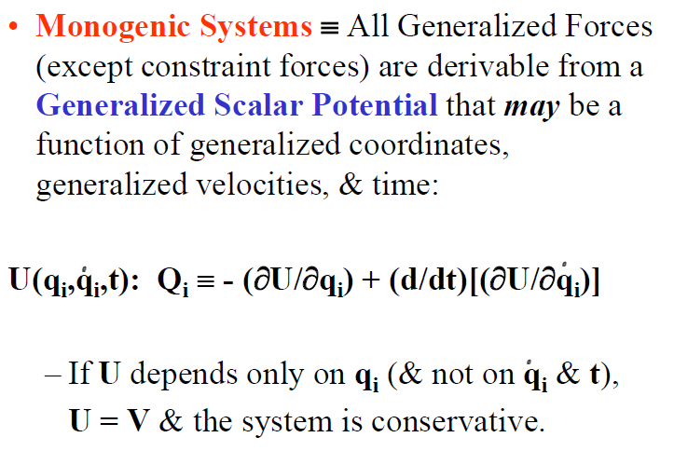

Slide 139
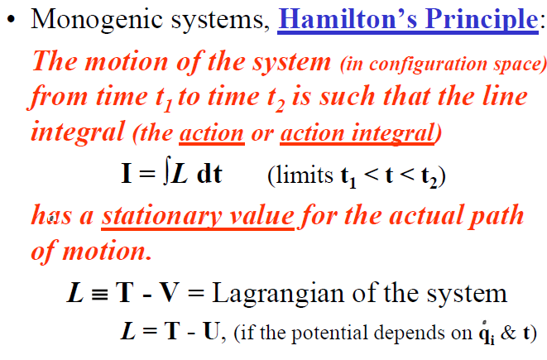

Slide 140


Slide 141


Slide 142


Slide 143


Slide 144


Slide 145


Slide 146


Slide 147


Slide 148


Slide 149


Slide 150
Solution to basic problem : The text proves that to minimize (or maximize)
J ≡ ∫f[y(x),y′(x);x]dx (limits x₁ < x < x₂)
or δJ = δ∫f[y(x),y′(x);x]dx =0
⇒ The functional f must satisfy:
(∂f/∂y) - (d[∂f/∂y′]/dx) = 0
≡ Euler’s Equation
Euler, 1744. Applied to mechanics
≡ Euler - Lagrange Equation
Various pure math applications,
Read on your own!

Slide 151


Slide 152


Slide 153


Slide 154


Slide 155


Slide 156
HP for Non-Holonomic Systems
Can formally extend HP to include some types of non-holonomic systems.
Derivation of Lagrange’s Eqtns: Holonomic constraint requirement does not appear until last step. (When δq_{i} are considered independent).
Holonomic constraints: m constraint eqtns:
f_{α}(q₁,q₂,…q_{n},t) = 0 (α = 1,..m)

Slide 157


Slide 158


Slide 159


Slide 160


Slide 161


Slide 162


Slide 163


Slide 164


Slide 165


Slide 166


Slide 167


Slide 168


Slide 169


Slide 170


Solution, page 1!!

Slide 171

Solution, page 2!!

Slide 172
Advantages of a Variational Principle Formulation
HP ⇒ δ∫Ldt = 0 (limits t₁ < t < t₂). An example of a variational principle.
Most useful when a coordinate system-independent Lagrangian L = T - V can be set up.
HP: “Elegant”. Contains all of mechanics of holonomic systems in which forces are derivable from potentials.
HP: Involves only physical quantities (T, V) which can be generally defined without reference to a specific set of generalized coords.
⇒ A formulation of mechanics which is independent of the choice of coordinate system!

Slide 173


Slide 174


Slide 175


Slide 176


Slide 177


Slide 178


Slide 179


Slide 180


Slide 181


Slide 182


Slide 183


Slide 184


Slide 185
Conservation Theorems & Symmetry Properties
Lagrange Method: A method to get the eqtns of motion. Solving them = math!
n degrees of freedom.
⇒ Need n eqtns of motion (2nd order diff. eqtns)
⇒ 2n constants of integration (2n initial conditions).
Sometimes, can easily integrate the eqtns of motion. Sometimes not (except numerically).
Even when we cannot integrate the eqtns of motion, can get a lot of info about PHYSICS of motion by considering Conservation Theorems.

Slide 186


Slide 187


Slide 188


Slide 189


Slide 190


Slide 191


Slide 192


Slide 193


Slide 194
Conditions for conservation of generalized momenta are actually MORE GENERAL than those used to derive conservation theorems for many particle systems.
Those in Ch. 1 needed assumptions of Newton’s 3rd Law in weak & strong forms for internal forces.
Present case: Generalized Momentum conservation theorems result even if these 3rd Law assumptions are violated!

Slide 195


Slide 196


Slide 197


Slide 198


Slide 199


Slide 200


Slide 201


Slide 202


Slide 203


Slide 204


Slide 205


Slide 206


Slide 207
Physics/Philosophy
Physical Significance of cyclic coords (translation or rotation):
If the q_{j} corresponding to a displacement is cyclic (& thus conjugate momentum is conserved):
⇒ System translation is as if it were rigid & has no effect on the problem. That is (we’ve shown), if the system is invariant under translation along a given direction n, the corresponding linear momentum along that direction is conserved.
Also, if q_{j} corresponding to a rotation is cyclic (& thus conjugate angular momentum is conserved):
⇒ System rotation is as if it were rigid & has no effect on the problem. That is (we’ve shown), if the system is invariant under rotation about a given direction n, the corresponding angular momentum along that direction is conserved.

Slide 208
Conservation Laws & Symmetry
Bottom line: The Generalized Momentum Conservation Theorems are closely connected with the Symmetry Properties of the system.
For example, spherically symmetric systems ALWAYS have all components of angular momentum conserved.
If the system has symmetry only about one axis (say, z) then angular momentum about that axis (L_{z}) is conserved.
If, by inspection, a system has some symmetry, can often use it to IMMEDIATELY conclude that some Generalized Momentum component is conserved.
⇒ There is an intimate connection between symmetry properties and conservation theorems. (More later on this!)

Slide 209


Slide 210


Slide 211


Slide 212


Slide 213


Slide 214


Slide 215


Slide 216


Slide 217


Slide 218


Slide 219


Slide 220


Slide 221


Slide 222


Slide 223


Slide 224


